Slide 1
Data Structures and Algorithms
Instructor:
Dr. Farrukh Hasan Syed
Farrukh.hassan@nu.edu.pk

Slide 2
Data structure
the organization of data (and its storage allocations in a computer)
Algorithm
a process or set of rules to be followed in calculations or other problem-solving operations, especially by a computer.
step-by-step instructions

Slide 3
When we use a computer to help us solve a problem, we typically are faced with a number of possible approaches.
For small problems, it hardly matters which approach we use, as long as we have one that correctly solves the problem.
For huge problems (or applications where we need to solve huge numbers of small problems), however, we quickly become motivated to devise methods that use time and space efficiently

Slide 4
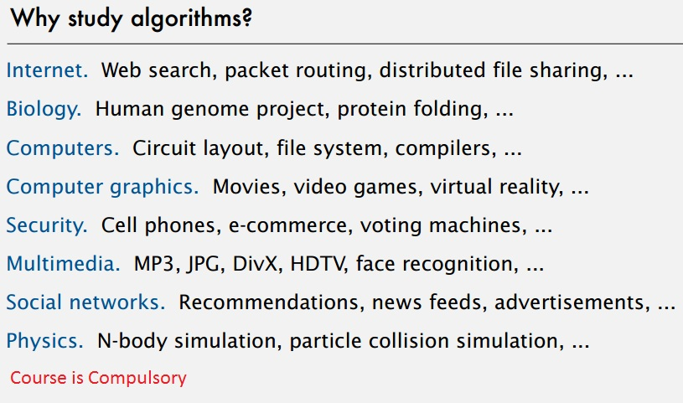

Slide 5
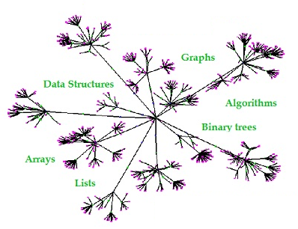
Data Structures

Slide 6

Algorithm
Specification of output as a function of input
Specification of input

Slide 7
Books
Data Structures and Algorithms in C++ 4th Edition by Adam Drozdek
Algorithms by Robert Sedgewick and Kevin Wayne

Slide 8
Some Data structures

Slide 9
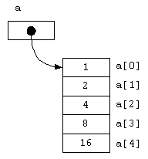
Arrays cannot be easily extended or reduced to fit the data set.
In an array, the elements have to be in a contiguous (connected and sequential) portion of memory.
Expensive to maintain new insertions and deletions.
Int array[5]
Insert 1, 2, 4, 8, 16, 32

Slide 10
If you want to keep the array sorted:
Insert 2,4,8,16,1

Slide 11
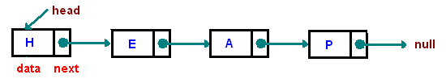
Linked List
Access time?

Slide 12

Primitive data types
Primitive data types, also known as basic data types or elementary data types, are the fundamental building blocks used to represent simple values in programming languages
These data types are supported directly by the programming language

Slide 13
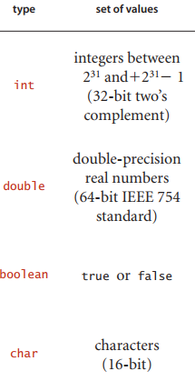

Slide 14
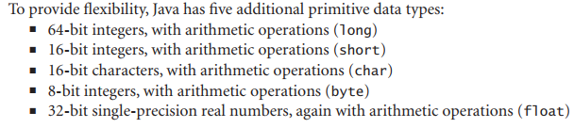

Slide 15
Abstract Data Types (ADT)
An abstract data type (ADT) is a data type whose representation is hidden from the client
Common examples of ADTs include stacks, queues, lists, sets, maps, and trees. These ADTs can have various implementations, such as using arrays, linked lists, or other data structures, but the ADT interface remains consistent regardless of the underlying implementation
In object-oriented programming, ADTs are often realized as classes or interfaces, where the class defines the data and the methods that operate on it, while the interface provides a contract specifying the available operations without specifying their actual implementation

Slide 16
Abstract Data Types
Abstract Data Types (ADTs) are a fundamental concept in computer science and programming that define a high-level description of data structures and the operations that can be performed on them, without specifying the underlying implementation details.
An ADT consists of two main components:
1. **Data Representation:** This defines the type of data that the ADT can hold. It specifies what kind of values can be stored and manipulated using the ADT.
2. **Operations:** These are the functions or methods that can be performed on the data stored within the ADT. Operations define how the data can be modified, accessed, and manipulated.

Slide 17
For example, let's consider the ADT of a "Stack":
1. **Data Representation:** The data in a stack is usually represented as a collection of elements where the most recently added element is placed on top, and the least recently added element is at the bottom.
2. **Operations:** A stack typically supports operations like "push" (to add an element to the top), "pop" (to remove and return the top element), "peek" (to see the top element without removing it), and "isEmpty" (to check if the stack is empty).

Slide 18
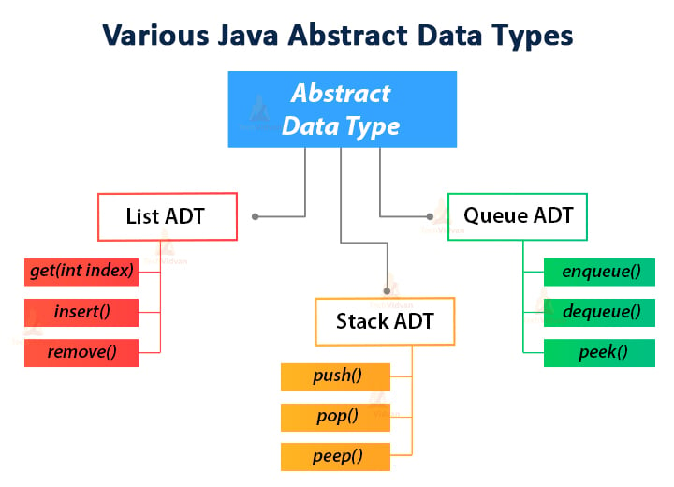

Slide 19
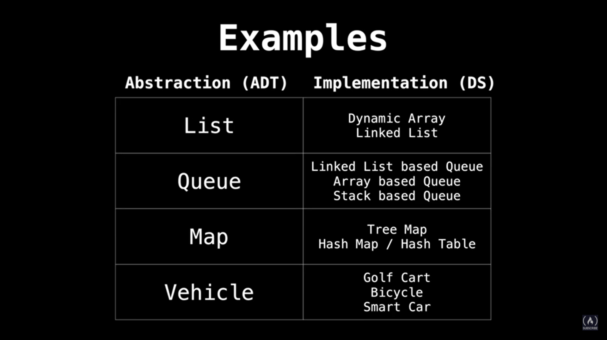

Slide 20
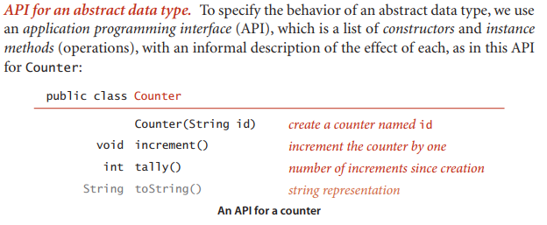

Slide 21
Benefits
1. **Encapsulation:** The internal details of how the data structure is implemented are hidden from the user, promoting information hiding and reducing complexity.
2. **Modularity:** ADTs can be reused across different parts of a program or in different programs altogether, as long as their operations are adhered to.
3. **Ease of Maintenance:** If the implementation of an ADT needs to be changed or improved, as long as the external interface (the operations) remains the same, other parts of the program using the ADT remain unaffected.

Slide 22

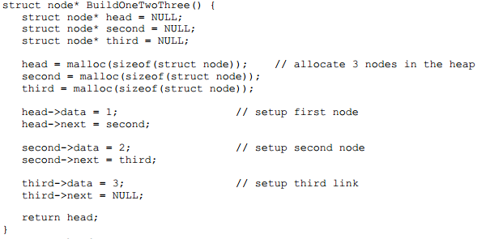

Slide 23
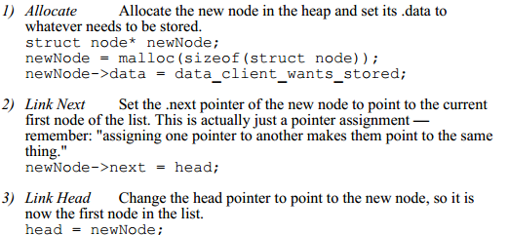

Slide 24
References
http://cslibrary.stanford.edu/103/LinkedListBasics.pdf
http://www.geeksforgeeks.org/delete-a-given-node-in-linked-list-under-given-constraints/

